Slide 1


Hii,
Iam Siddhika
Welcome to Power BI Series
Part -58

Slide 2



I’m very excited to dive into this with you all!
Are you ready to enhance your data visualization skills?
We focus only on the most used and important Visuals
Today Content
VISUALIZING DATA
FILTERING OPTIONS
CONDITIONAL FORMATTING

Slide 3
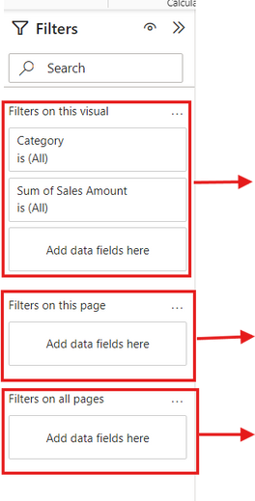


FILTERING OPTIONS
There are three types of filters you can use from the Filters pane:
got it?
Visual-level filters: These apply only to specific visuals.
Page-level filters: These apply to all visuals on the current report page.
Report-level filters: These apply to all visuals across all report pages.

Slide 4
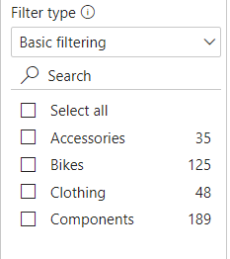
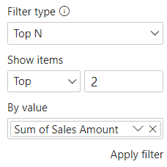
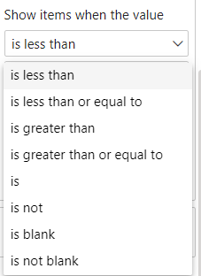

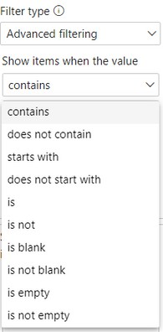

FILTERING OPTIONS
Go and exlpore
Basic Options
Top N Options
Advanced (Values)
Filters can be set up using simple selections, logical conditions, or Top N rules.
Advanced (Text)

Slide 5
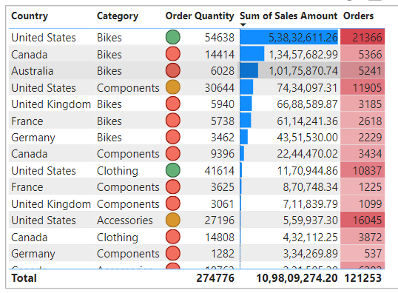

CONDITIONAL FORMATTING
check next slide for applying this conditional formating
Conditional formatting lets you change the appearance of Table or Matrix visuals based on the values in the cells.

Slide 6
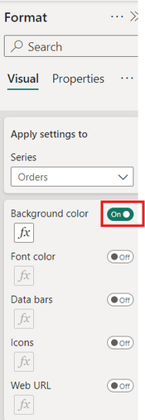
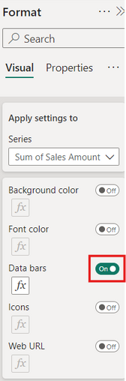
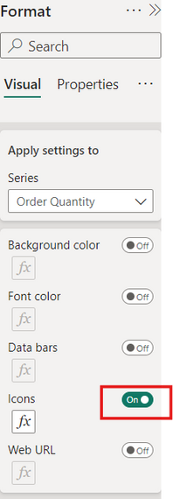
CONDITIONAL FORMATTING
go and format your visual
You can find conditional formatting options in the Format pane, under Cell elements.
Options include background color, font color, data bars, icons, and Web URLs.

Slide 7


Thank you for joining me today to learn about Part -58 of Power BI!
Remember, Effective data visualization is crucial for turning data into meaningful insights and compelling narratives with Power BI.
Stay tuned for more insights and tips on Power BI in our next Series.
Follow
Siddhika Shah

